Slide 1
AI Based Chatbot for Farmers
(Presenter): P. Prudhvi Krishna
(Authors): Dr. Tejal Agarwal
Dr. Ankit Agrawal
Presented on 30 May 2024,
Duration 7mn + 3mn
During the “Innovate for Impact” workshop
In collaboration with the ITU AI for Good Scholars

Slide 2
C o n t e n t s
Problem to be addressed
Literature Survey
Our Solution
Current Status
Future works

Slide 3
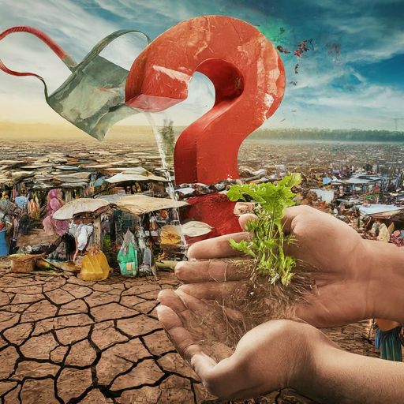
Problem to be addressed
Case study-1:
The agriculture sector in India faces a multitude of challenges ranging from climate conditions to soil health, water management, crop breeding, market access, and policy implementation.
Case study-2:
Farmer’s decisions are being influenced by various factors, leading to challenges in optimizing crop production and resource management.
climate condition
soil fertility
crop breeding
water management
seed quality
Pesticides and Fertilizers
Market access
government schemes and policies
Training and education

Slide 4
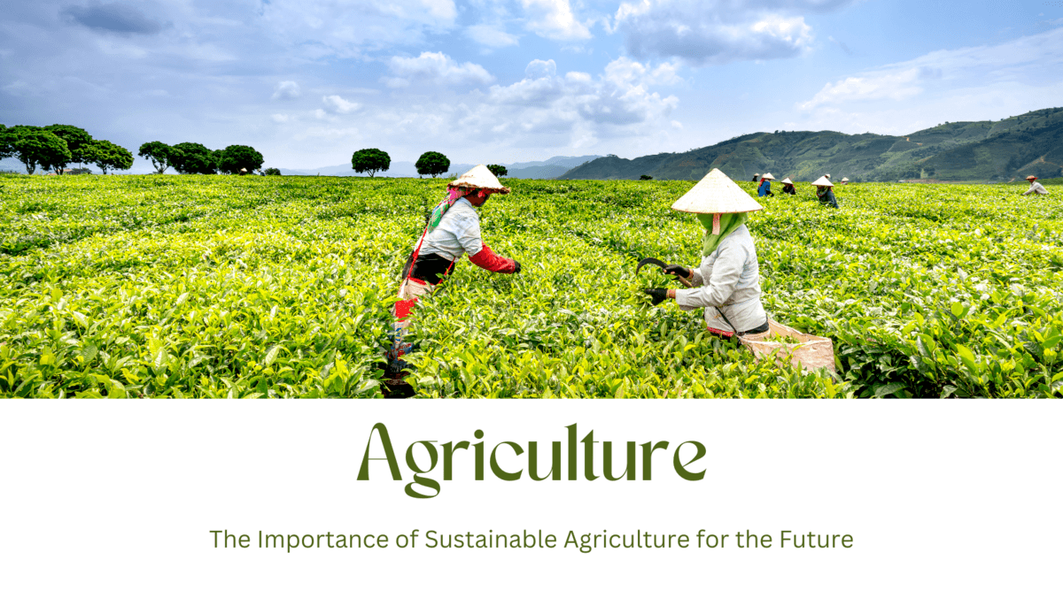
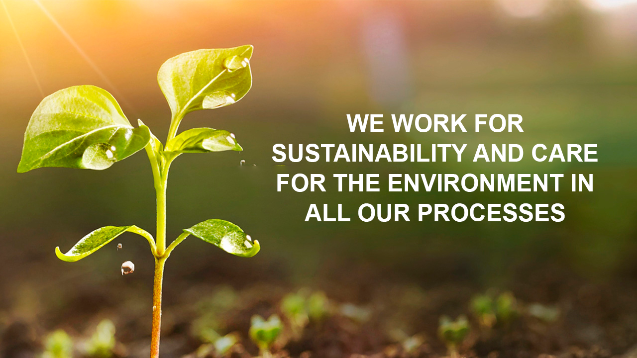
Focusing on the Sustainable Development Goals:
SDG 2: Zero Hunger
SDG 3: Good Health and Well-being.
SDG 6: Clean water and Sanitation
SDG 9: Industry, Innovation, and Infrastructure.
SDG 12: Responsible Consumption and Production.
SDG 15: Life on Land
Can we address the above Sustainable Development Goals: Yes ✅

Slide 5
Background of Existing body of work/Literature survey/gaps
Background Study | Benefits | Drawback /gaps
Farmers in India are using AI for agriculture | World Economic Forum (weforum.org) India at a glance | FAO in India | Food and Agriculture Organization of the United Nations Artifical Intelligence (AI) in Agriculture Smart Agriculture with AI Sensor by Using Agrobot | Potential for Nutritional Improvement Improved Crop Monitoring Early Disease Detection Sustainable Farming Practices Increased Efficiency and Productivity | No Accessibility to AI Lack of Knowledge and Training Data not available High Initial Costs No informed decisions

Slide 6
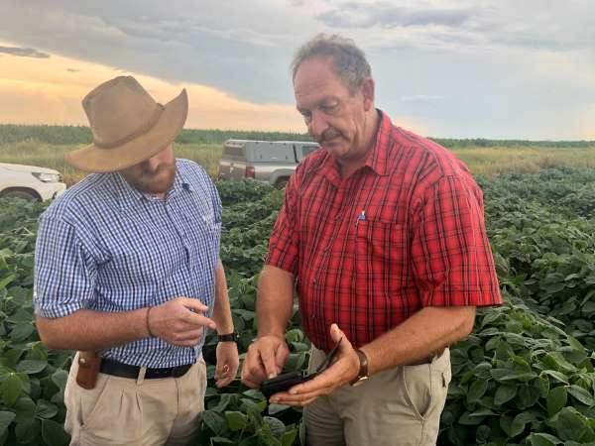
Our solution: AI Based Chatbot for Farmers
Revolutionizing the agriculture sector by unifying multiple government agency's data using Artificial intelligence models.
Soil land data
Geolocation coordinates
Climate and water data
Government policies
Building an AI chatbot

Slide 7
Q & A by Ramu
Native Language: తెలుగు
English
1. Ramu: Logins
> Chatbot: Select the Language: 1. English, 2. తెలుగు, 3. హిందీ, etc. ….
2. Ramu: Selects his Native Language – తెలుగు
> Chatbot: (నేను మీకు ఏ విధం గ సహాయపడగలను)
3. Ramu: (నా దెగర ల్యాండ్ ఉంది. నేను ఎం పంట పండించాలి)
> Chatbot: (మీరు మీ ల్యాండ్ సమాచారం మరియు స్థలం సమాచారం నాకు పెట్టండి)
4. Ramu: Uploads the image and info
> Chatbot: నేను మీరు పెట్టిన సమాచారం అంతా చూసేను. ఇది చలి కాలం, మీరు పెట్టిన ఫొటోస్ లో సాయిల్ అర్ధం చేసుకొని, మీరు కార్రోట్స్ పంట వేయండి. మీకు దెగర లో ఉన్న గ్రామా పంచాయత్ ఆఫీస్ ఉంది, అందులో సబ్సిడేన్సు అండ్ పధకాలు తెలుసుకోవచ్చు.
5. Ramu: Thank you
1. Ramu: Logins
> Chatbot: Hello, how can I help you.
2. Ramu: I have a land, which crop I should grow.
> Chatbot: Don’t worry Ramu, Please share your land details and picture of the land and also please enable GPS.
3. Ramu: Uploads the image and info
> Chatbot: i. Analyze the soil ii. Gets the geo-location coordinates iii. Analyze water availability in that region --- Ramu, This was winter season. Based on your land area and soil fertility it’s good to grow Carrots in this season There is a near by grama panchayat office. For the best subsidence and schemes you can visit. Tomorrow in your area, training is going on please attend ramu.
4. Ramu: Thank you

Slide 8
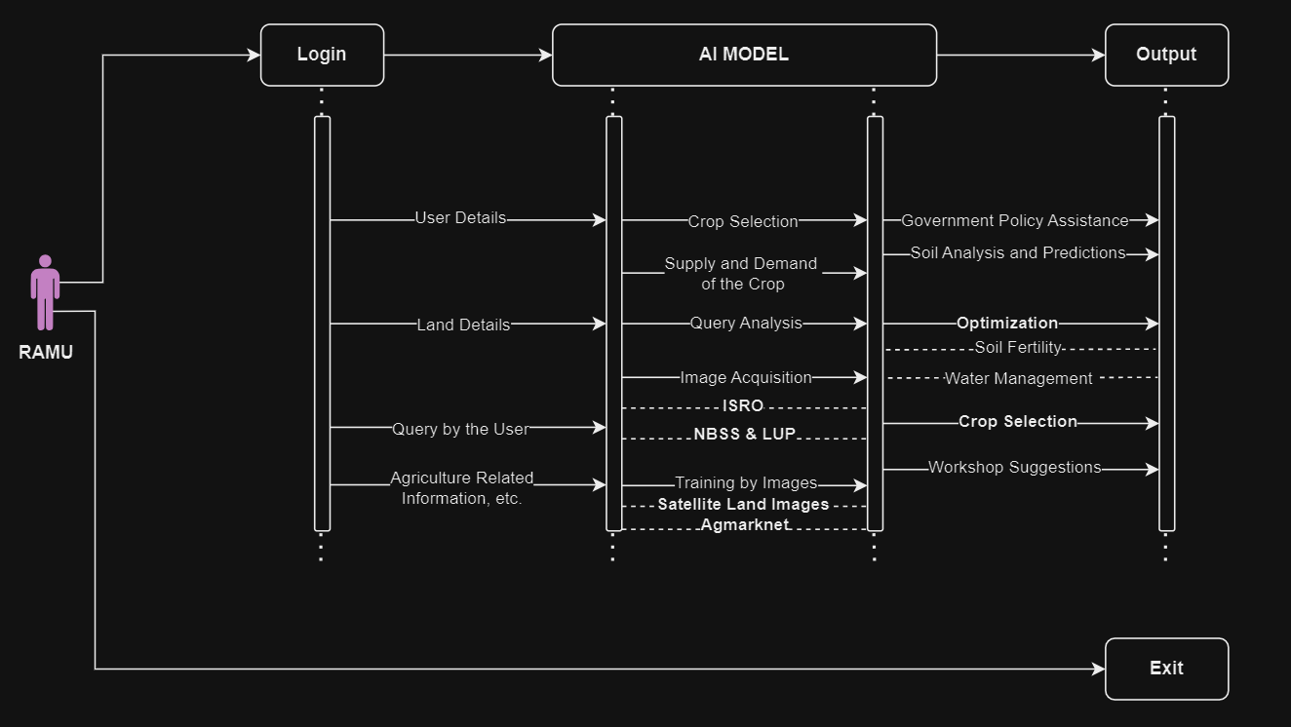
Sequence Diagram / Flow
ISRO ~ Indian Space Research Organization
NBSS ~ National Bureau of Soil Survey
IASRI ~ Indian Agricultural Statistics Research Institute
LUP ~ Land Use Planning

Slide 9
Current Status
01: Data Integration and Standardization – Collected the data from various resources from Telangana
02: Machine Learning Models – Building an XGB regressor model to forecast the prediction of crop
03: User Friendly Interface - To interact with the AI driven decision support system
References – Data collected from:
Home - Open Data Telangana
Agriculture Marketing (agmarknet.gov.in)
Home | Open Government Data (OGD) Platform India

Slide 10
Future works
Analyzing the land images from ISRO
Prediction of soil fertility using images
Contributions to ITU, FG – AN
Collaborations with ITU

Slide 11
References
[1] https://www.weforum.org/agenda/2024/01/how-indias-ai-agriculture-boom-could-inspire-the-world/
[2] https://www.fao.org/india/fao-in-india/india-at-a-glance/en/
[3] S. Y. Liu, "Artificial Intelligence (AI) in Agriculture," in IT Professional, vol. 22, no. 3, pp. 14-15, 1 May-June 2020, doi: 10.1109/MITP.2020.2986121.
keywords: {Special issues and sections;Agriculture;Artificial intelligence;Sustainable development},
[4] B. Ragavi, L. Pavithra, P. Sandhiyadevi, G. K. Mohanapriya and S. Harikirubha, "Smart Agriculture with AI Sensor by Using Agrobot," 2020 Fourth International Conference on Computing Methodologies and Communication (ICCMC), Erode, India, 2020, pp. 1-4, doi: 10.1109/ICCMC48092.2020.ICCMC-00078. keywords: {Temperature sensors;Cloud computing;Temperature dependence;Crops;Soil;Internet of Things;Artificial intelligence;Agriculture;Agrobot;Arduino and cloud based IOT agriculture.},

Slide 12
Thank You
P. Prudhvi Krishna,
Dr. Tejal Agarwal
Dr. Ankit Agrawal
Mr. Vishnu Ram
INDIA

